Slide 1


Day: 14 Designing Historic & Income Currency Translation
Configure Historic & Income Related Currency Translation

Slide 2

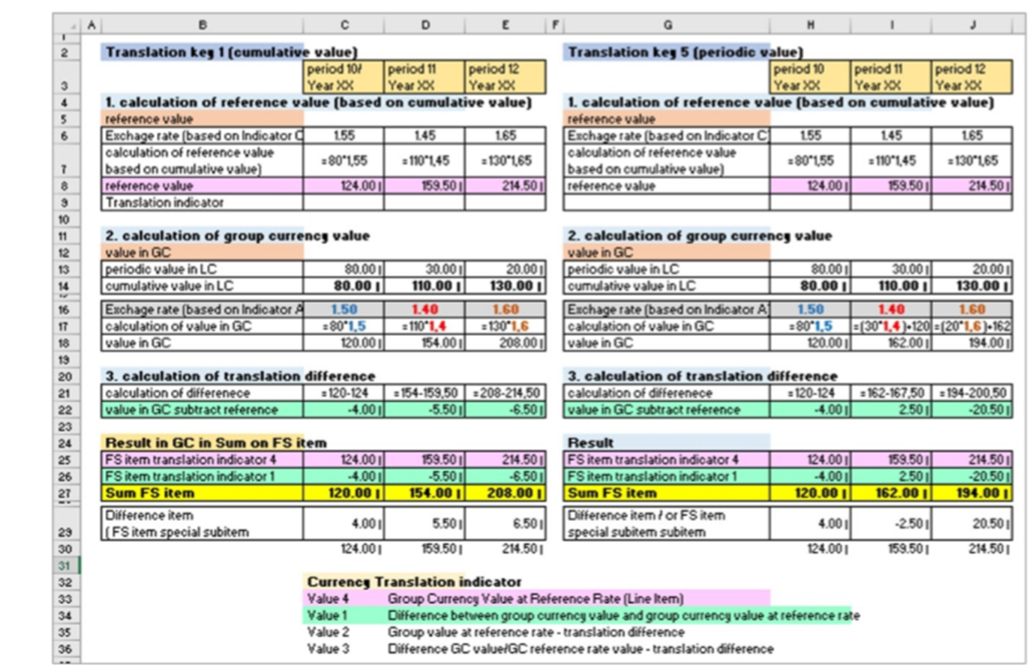

Slide 3
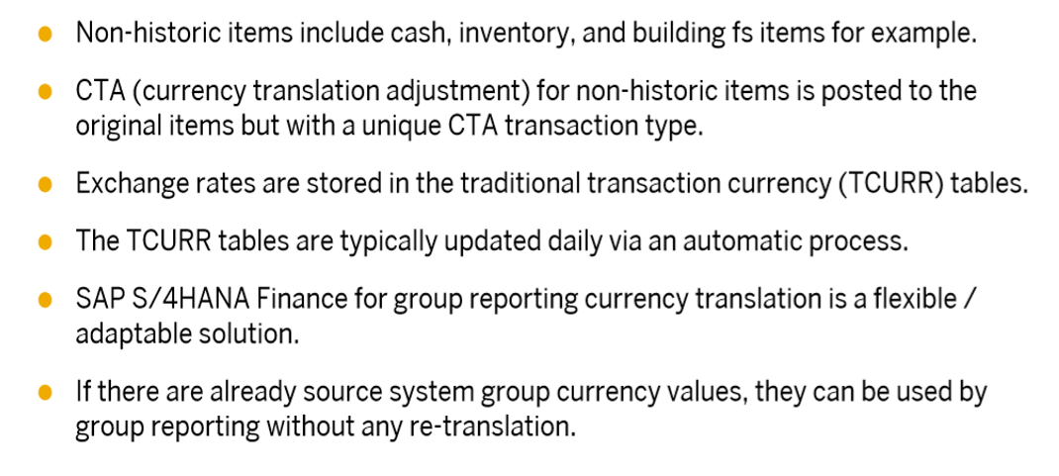
Currency Translation for Non Historic items:

Slide 4
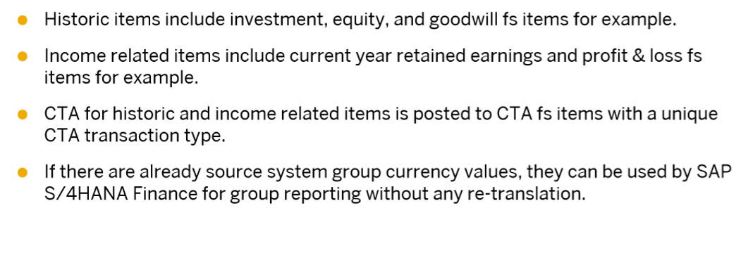
Currency Translation For Historic and Income Related Income

